Slide 1


Parking Lot Counter
Experiment 5
Raphael S. Nano
CPE160P / B1
Computer Engineering Department
School of Electrical, Electronics, and Computer Engineering

Slide 2
Introduction: Parking Lots
The number of vehicles in modern times increased drastically due to the evolution and development of technology
Need for containment and spaces for vehicles arose as their number increased
Parking lots and parking spaces became a necessity

Slide 3
Objectives
To be able to demonstrate how a parking lot counter works.
To be able to apply embedded system in counting the number of cars entered and exited the parking lot.
To be able to demonstrate how the gate opens (if there is/are available parking slot), and closes if there are no available parking slot.
To be able to apply what you have learned in Microprocessor and Logic Circuits and Switching Theory.
To be able to apply embedded systems in a simple handshaking using Arduino Kit

Slide 4
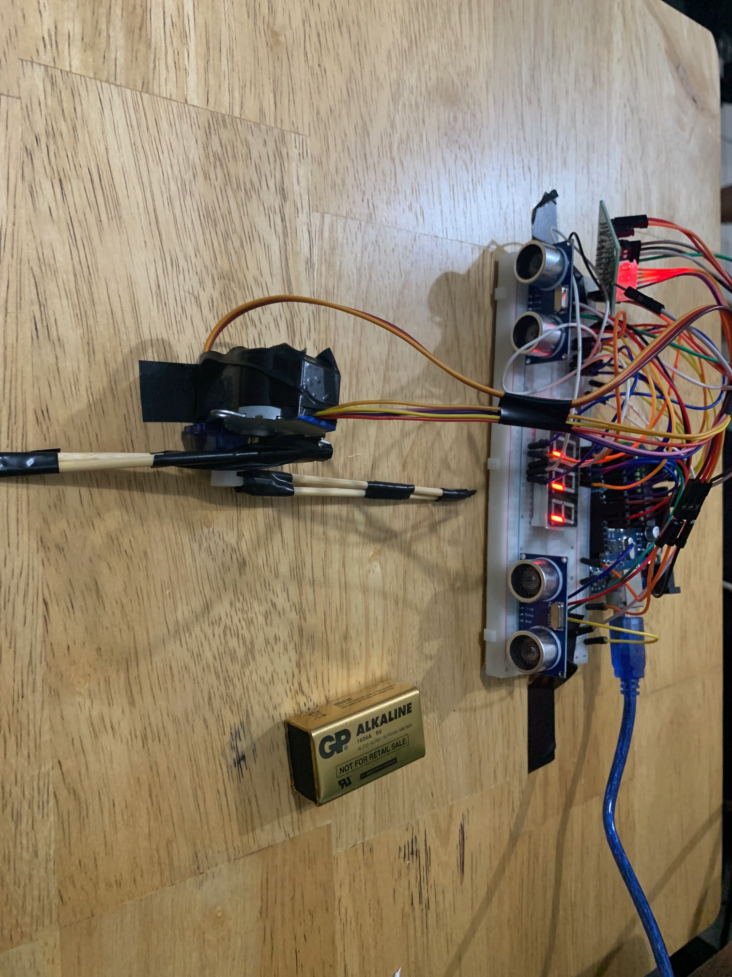
Materials
Arduino Kit
Arduino Uno
SG90 Servo Motor
28BYJ-48 Stepper Motor
2 HC-SR04 Ultrasonic Distance Sensor
1 4-Digit seven segment display

Slide 5
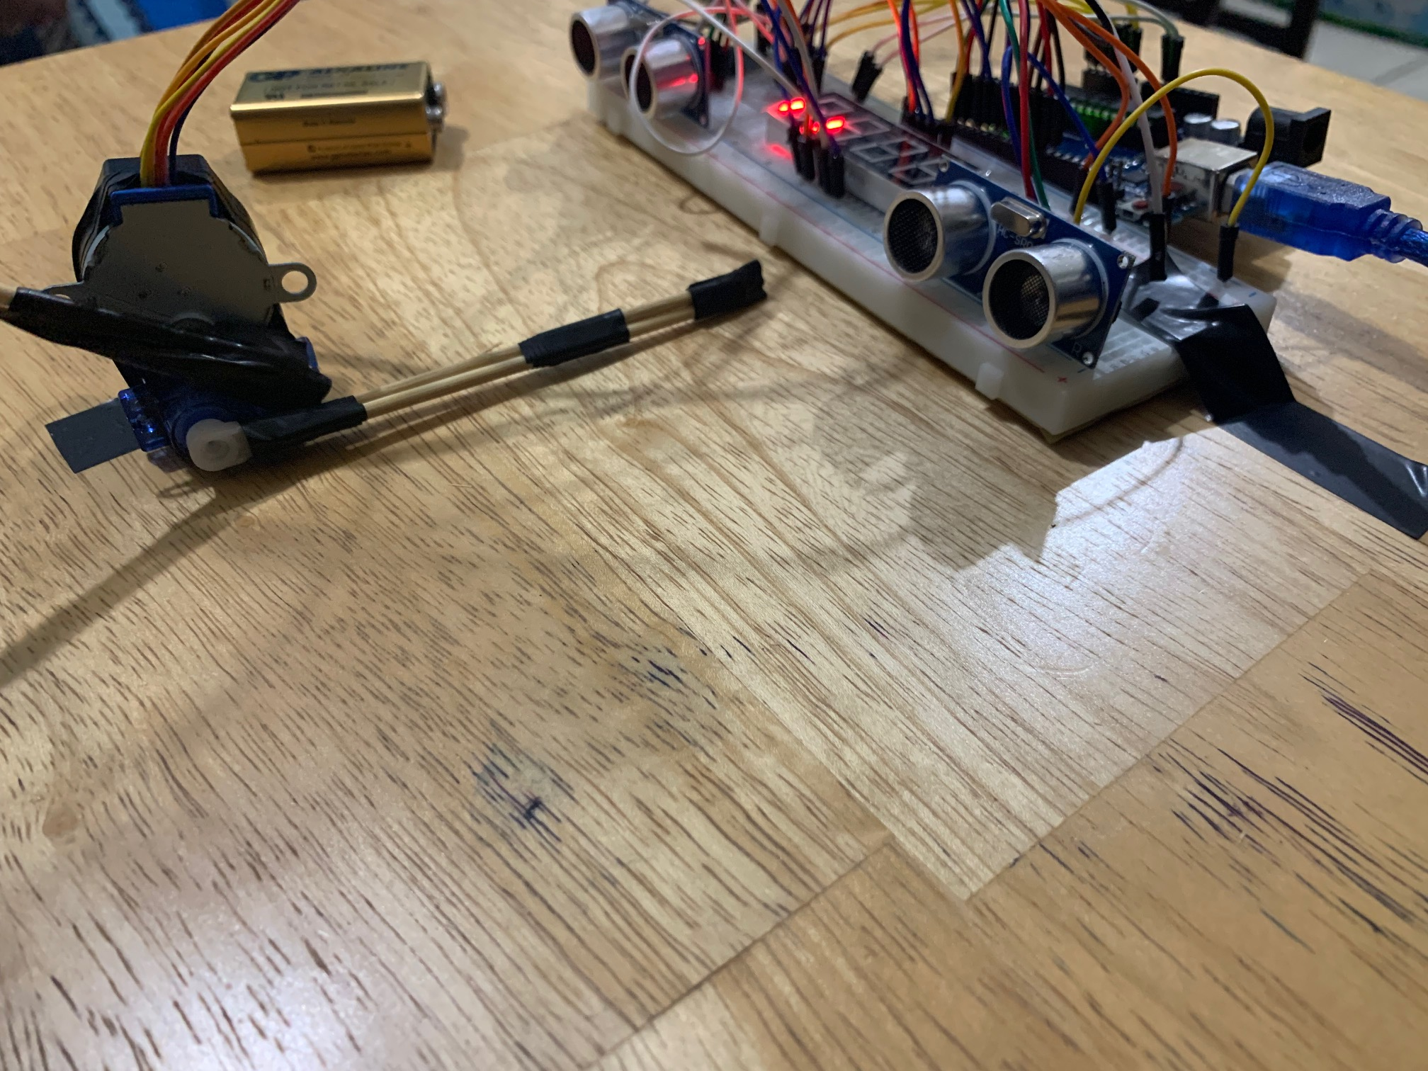
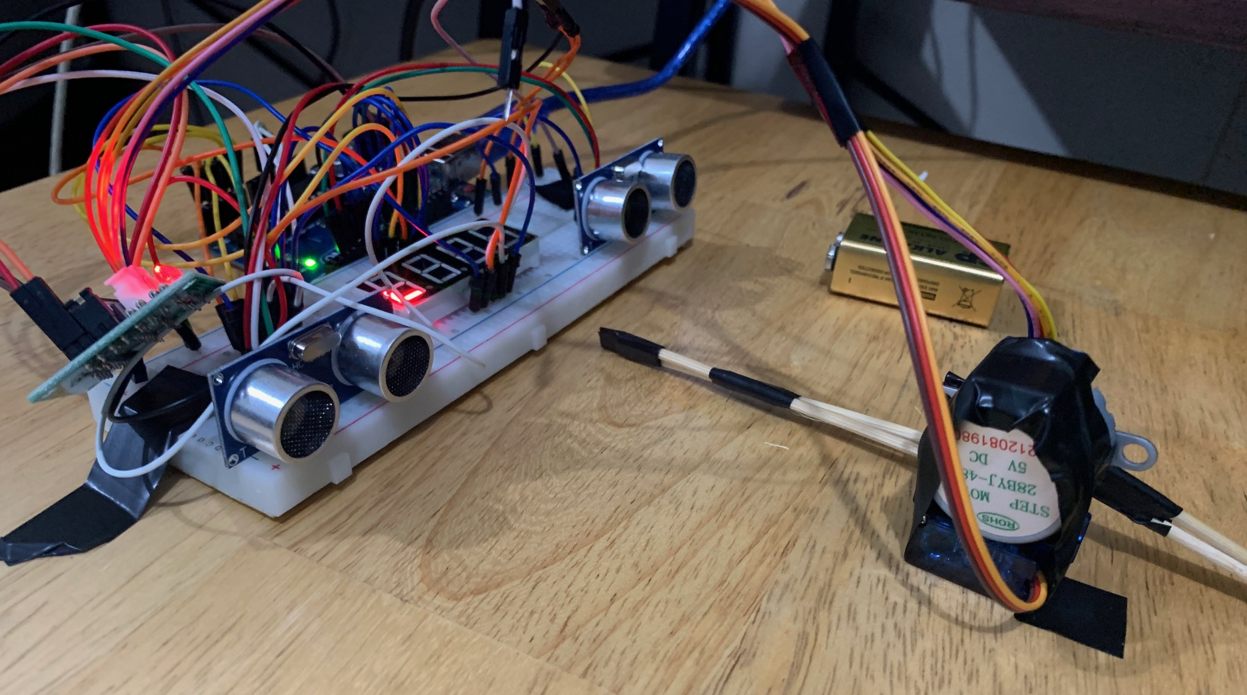
Discussion: Sensors
There are two pathways: entrance and exit
The sensors determine the entering and exiting of a car
Distance was computed using D = (Speed*Time)/2
Entering pathway: 10; Exiting pathway: 6

Slide 6
Discussion: Motors
Motors go up every time the sensor detects an object
Stepper motor is used for the entrance, and servo motor is used for the exit
Fucntions stepUp(), stepDown(), motorUp(), and motorDown() were used

Slide 7
Discussion: Display
First two digits are for the occupied slots
Last two digits are for the available slots
If a car enters, occupied slots increase and available slots decrease
If a car exits, occupied slots decrease and available slots increase

Slide 8
Conclusion
Parking lot counter works wherein if a car enters, occupied slots increase and the stepper motor raises the gate, and if a car exits, available slots increase, and the servo motor raises the gate
If ultrasonic distance sensors sense an object within critical distance, the value of the count is being updated
Motors rotate to raise the gate after sensing an object
Series connections, pin configurations, and triggering of sensors prove the application of microprocessors, logic circuits, and switching theory
Various variables, functions, and calling of functions were employed to develop the parking lot counter

